Slide 1

Date: | Human Biology Year 12 ATAR
Do Now Complete the past exam question given, under test conditions (not for actual marks) Lesson Agenda 1: Do Now 2: CNS Protection, Comparing NS and Endocrine systems 3: Work on Review Worksheet CNS Protection 4: Lesson summary and wind-up Suggested Study Complete review worksheet, mark and correct using answer key on Connect. Read through today’s notes and textbook section NEXT LESSON Past Exam Question Diseases of the Nervous System | Learning Aims Describe how the skull and vertebral column protect the nervous system. Describe the structure of the meninges in the skull and spinal column. Discuss how the meninges protect the CNS Describe the content of cerebrospinal fluid (CSF) and discuss where it is produced. Explain the functions of the CSF Discuss similarities between the Nervous and Endocrine Systems Discuss differences between the Nervous and Endocrine Systems
 | Key Vocabulary Cranium Meninges Cerebrospinal fluid Blood-brain barrier Pia Mater Arachnoid Mater Dura Mater

Slide 2
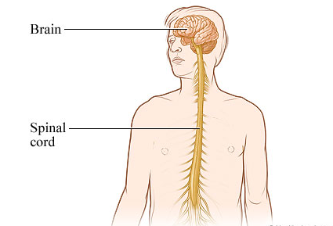
The Central Nervous System (CNS) - protection
Chapter 4 Human Perspectives – The Nervous System is highly organised

Slide 3
Central Nervous System
Brain and Spinal Cord
Interprets, Coordinates and Integrates
input from sensory nervous system
output to motor nervous system
Delicate and Vital
Fragile, does not heal or regenerate well
3 structures for protection:
Bone
Meninges
Cerebro-Spinal Fluid (CSF)
Learning Aim: Describe how the skull and vertebral column protect the nervous system.

Slide 4
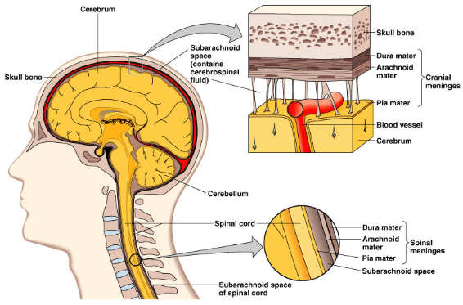
Protection of CNS
Bone
Cranium (skull) houses the brain
Spinal cord within vertebral canal in vertebrae
Rigid structure to protect from penetrating
and pressure injuries.
Meninges
3 layers of connective tissue
Between bone and CNS
Fibrous outer layer – dura mater “tough mother” – stuck to inside of skull.
Loose mesh middle layer – arachnoid mater – “spider mother” – allows for flow of CSF
Subarachnoid space – cerebrospinal fluid flows through this space.
Delicate inner layer – pia mater – “gentle mother”
Blood vessels
Sticks closely to surface of brain, and spinal cord
Learning Aim: Describe the structure of the meninges in the brain.

Slide 5
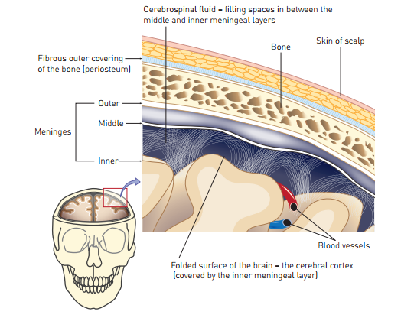
Learning Aim: Describe the structure of the meninges in the brain.

Slide 6
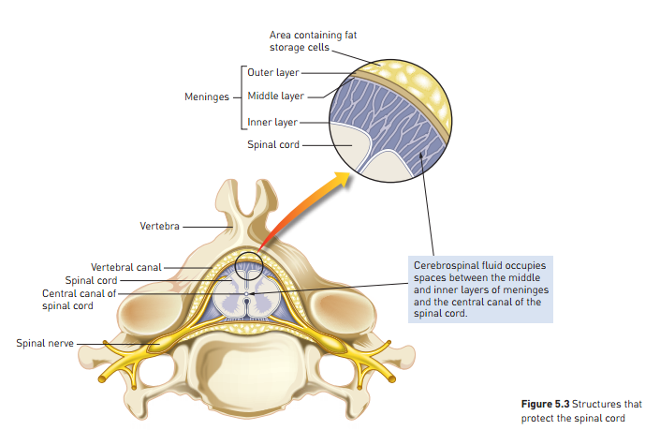
Learning Aim: Describe the structure of the meninges in the spinal cord.

Slide 7
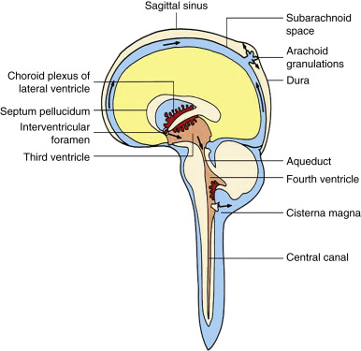
Protection of CNS
Cerebrospinal Fluid (CSF)
Flows between middle and inner layers of meninges
Formed from blood, circulates and eventually re-enters blood.
Circulates through cavities in brain and canal in spinal cord
Clear, watery fluid:
Few cells
Glucose, protein, urea, salts
3 functions:
Protection
Shock absorber to protect from impact
Barrier between blood vessels and CSF is quite tight “blood-brain barrier” – protects against entry of bacteria and some other particles
Support
Supports the fragile brain tissue – cushions it from contact with the skull and floats it within the cranial cavity
Transport
Transports nutrients and wastes to and from cells of brain and spinal cord
Learning Aim: Describe the production and composition of the CNS, and discuss how the meninges protect the CNS.

Slide 8
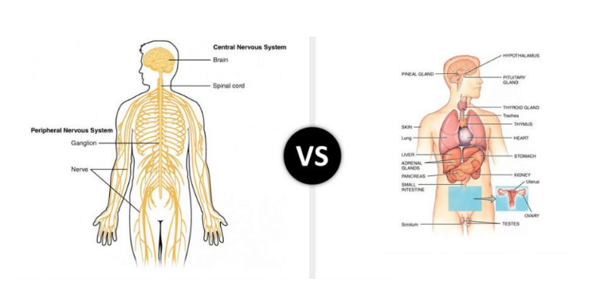
Nervous and Endocrine Systems: Comparison

Slide 9
Nervous and Endocrine System Comparison - Similarities
Both involved in sending messages from one part of the body to another
Some substances function as both neurotransmitters AND hormones eg:
Dopamine
ADH (Anti-Diuretic Hormone)
The two systems interact, eg:
Hypothalamus receives neural messages and can respond by triggering an endocrine message.
Sympathetic NS simulation during fight or flight triggers release of adrenalin from adrenal medulla.
Some hormones are secreted by neurons eg:
Oxytocin from Posterior Pituitary neurons
Some hormones and neurotransmitters have similar effects on target cells/tissues
Noradrenalin and Glucagon both act on liver to cause glycogen to glucose.
Noradrenalin and Adrenaline have very similar effects on tissues.
Learning Aim: List similarities between the endocrine and nervous systems.

Slide 10
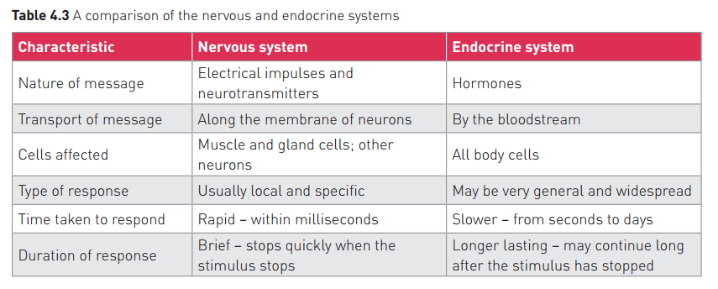
Nervous and Endocrine System Comparison - Differences
Learning Aim: List differences between the endocrine and nervous systems.

